Slide 1
7. Multivariate r.v. and its functions

Slide 2
Content
1. Multivariate random variable
2. Common Multivariate distribution
3. Function of Multivariate random variable and its
distribution
4. Sample mean and Sample Variance
5. Some distributions in statistics

Slide 3
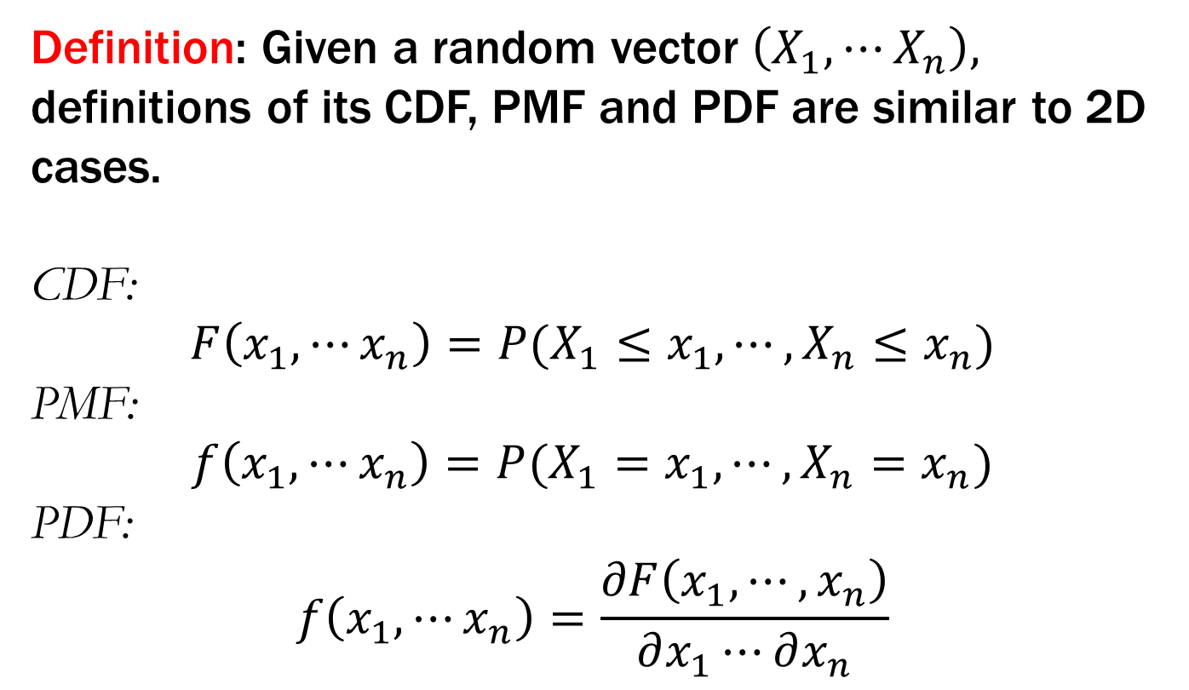
7.1 Multivariate random variable
Definition: Given a random vector $\left(X_{1},⋯X_{n}\right),$ definitions of its CDF, PMF and PDF are similar to 2D cases.
CDF:
$$F\left(x_{1},⋯x_{n}\right)=P(X_{1}≤x_{1},⋯,X_{n}≤x_{n})$$
PMF:
$$f\left(x_{1},⋯x_{n}\right)=P(X_{1}=x_{1},⋯,X_{n}=x_{n})$$
PDF:
$$f\left(x_{1},⋯x_{n}\right)=\frac{∂F\left(x_{1},⋯,x_{n}\right)}{∂x_{1}⋯∂x_{n}}$$

Slide 4
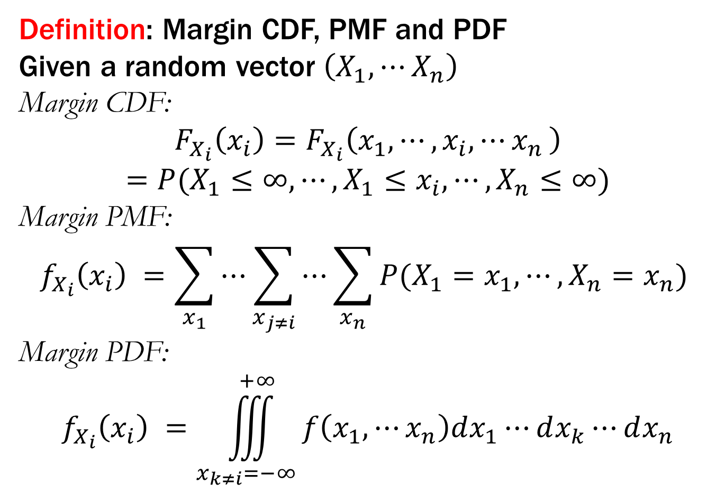
7.1 Multivariate random variable
Definition: Margin CDF, PMF and PDF
Given a random vector $\left(X_{1},⋯X_{n}\right)$
Margin CDF:
$$F_{X_{i}}\left(x_{i}\right)=F_{X_{i}}\left(x_{1},⋯,x_{i},{⋯x}_{n}\right)$$
$$=P(X_{1}≤∞,⋯,{X_{1}≤x_{i},⋯,X}_{n}≤∞)$$
Margin PMF:
$$f_{X_{i}}\left(x_{i}\right) =\sum_{x_{1}}{⋯\sum_{x_{j≠i}}{⋯\sum_{x_{n}}{P(X_{1}=x_{1},⋯,X_{n}=x_{n}) }}}$$
Margin PDF:
$$f_{X_{i}}\left(x_{i}\right) =\iiint_{x_{k≠i}=−∞}^{+∞}{f\left(x_{1},⋯x_{n}\right)dx_{1}⋯dx_{k}⋯dx_{n}}$$

Slide 5
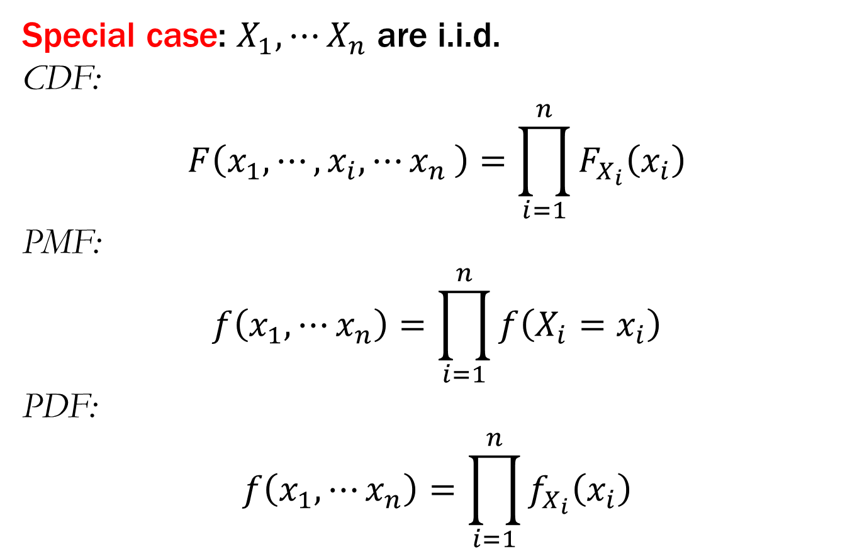
7.1 Multivariate random variable
Special case: $X_{1},⋯X_{n}$ are i.i.d.
CDF:
$$F\left(x_{1},⋯,x_{i},{⋯x}_{n}\right)=\prod_{i=1}^{n}{F_{X_{i}}\left(x_{i}\right)}$$
PMF:
$$f\left(x_{1},⋯x_{n}\right)=\prod_{i=1}^{n}{f\left(X_{i}=x_{i}\right)}$$
PDF:
$$f\left(x_{1},⋯x_{n}\right)=\prod_{i=1}^{n}{f_{X_{i}}\left(x_{i}\right)}$$

Slide 6
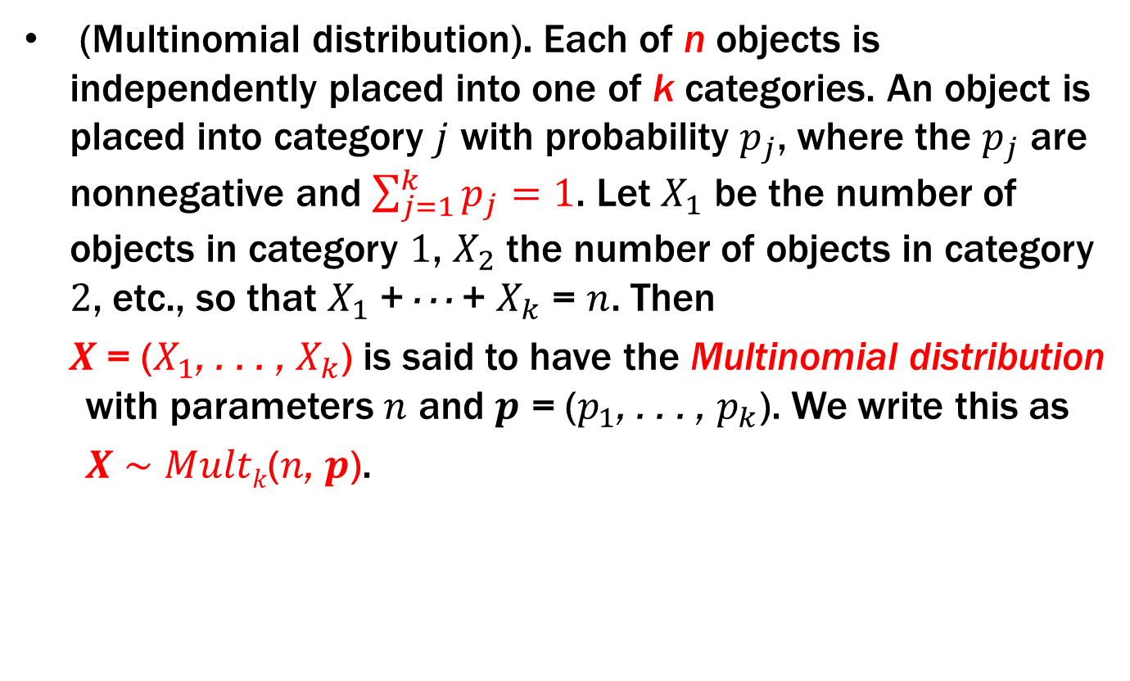
7.2 Common Multivariate distributions
(Multinomial distribution). Each of n objects is independently placed into one of k categories. An object is placed into category $j$ with probability $p_{j}$, where the $p_{j}$ are nonnegative and $\sum_{j=1}^{k}{p_{j}=1}$. Let $X_{1}$ be the number of objects in category $1$, $X_{2}$ the number of objects in category $2$, etc., so that $X_{1}$ + · · · + $X_{k}$ = $n$. Then
$X$ = ($X_{1}$, . . . , $X_{k}$) is said to have the Multinomial distribution with parameters $n$ and $p$ = ($p_{1}$, . . . , $p_{k}$). We write this as
$X$ $\sim$ $Multk$($n$, $p$).

Slide 7
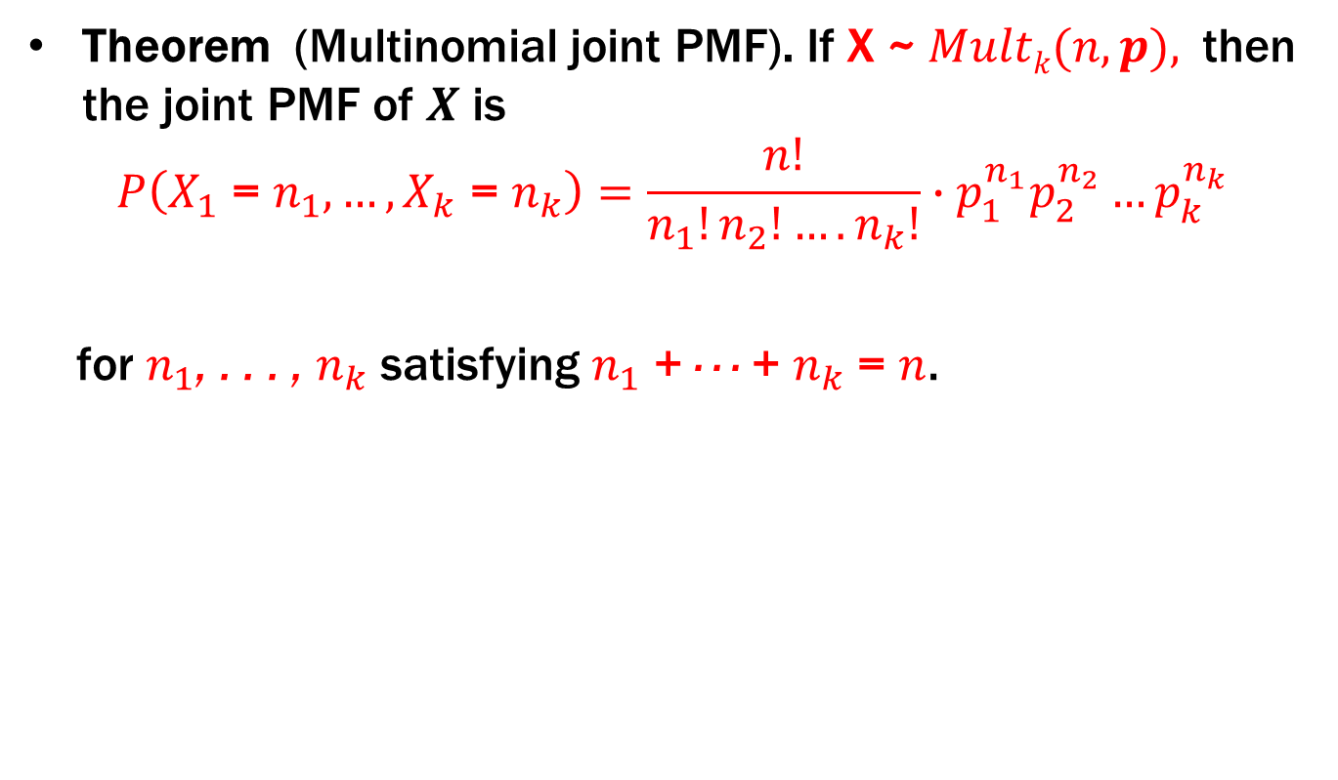
7.2 Common Multivariate distributions
Theorem (Multinomial joint PMF). If X ~ $Multk(n, p),$ then the joint PMF of $X$ is
$$P\left(X_{1} \text{= }n_{1}, …,X_{k} \text{= }n_{k}\right)=\frac{n!}{n_{1}!n_{2}!….n_{k}!}∙p_{1}^{n_{1}}p_{2}^{n_{2}}…p_{k}^{n_{k}}$$
for $n_{1}$, . . . , $n_{k}$ satisfying $n_{1}$ + · · · + $n_{k}$ = $n$.

Slide 8

7.2 Common Multivariate distributions
Theorem 7.4.3 (Multinomial marginals). If $X$ $\sim$ $Multk$($n$, $p$), then $X_{k}\sim$ $Bino(n,p_{k}$).

Slide 9
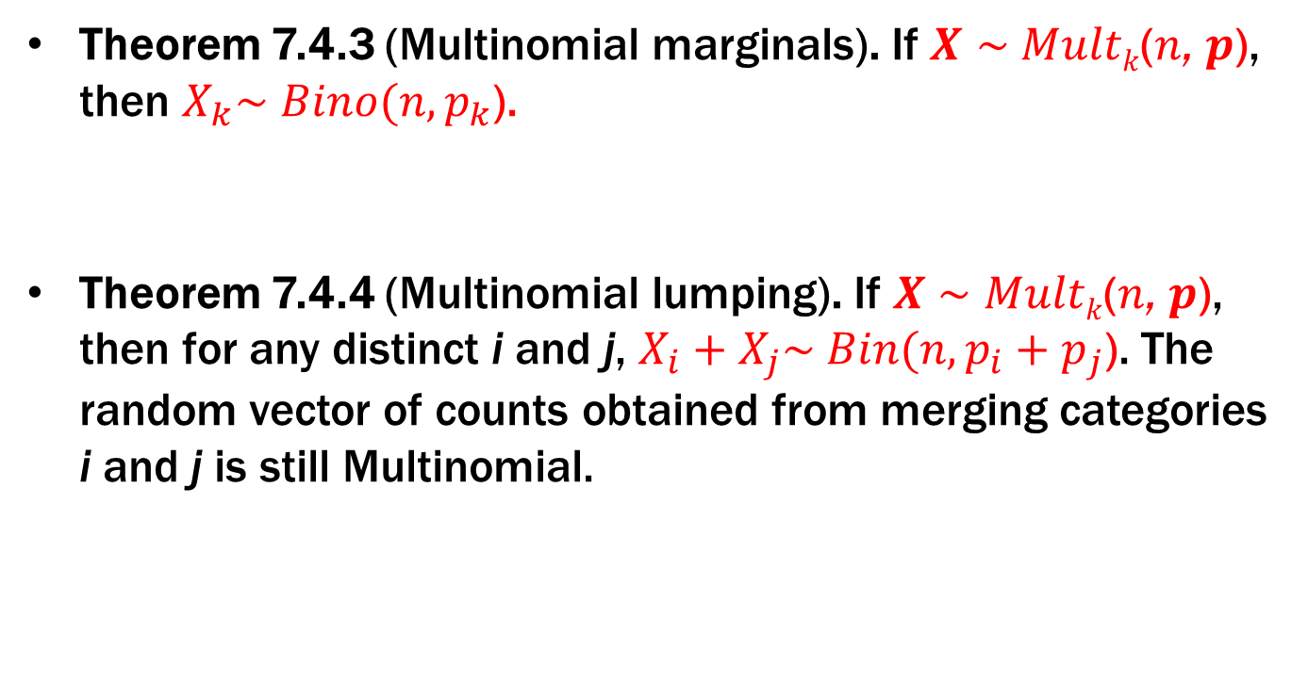
7.2 Common Multivariate distributions
Theorem 7.4.3 (Multinomial marginals). If $X$ $\sim$ $Multk$($n$, $p$), then $X_{k}\sim$ $Bino(n,p_{k}$).
Theorem 7.4.4 (Multinomial lumping). If $X$ $\sim$ $Multk$($n$, $p$), then for any distinct i and j, $X_{i}+X_{j}\sim$ $Bin(n,{p_{i}+p}_{j}$). The random vector of counts obtained from merging categories i and j is still Multinomial.

Slide 10

7.2 Common Multivariate distributions
Theorem 7.4.5 (Multinomial conditioning).
If $X$ $\sim$ $Multk$($n$, $p$), then
$\left(X_{2}, …,X_{n}\right)|X_{1}$ $=n_{1}$ $\sim$ ${Mult}_{k−1}$($n−n_{1}$, $\left(p_{2}^{′}, …,p_{n}^{′}\right)$),
  Where $p_{j}^{′}={p_{j}}/{\left(p_{2}+…+p_{n}\right)}$.

Slide 11
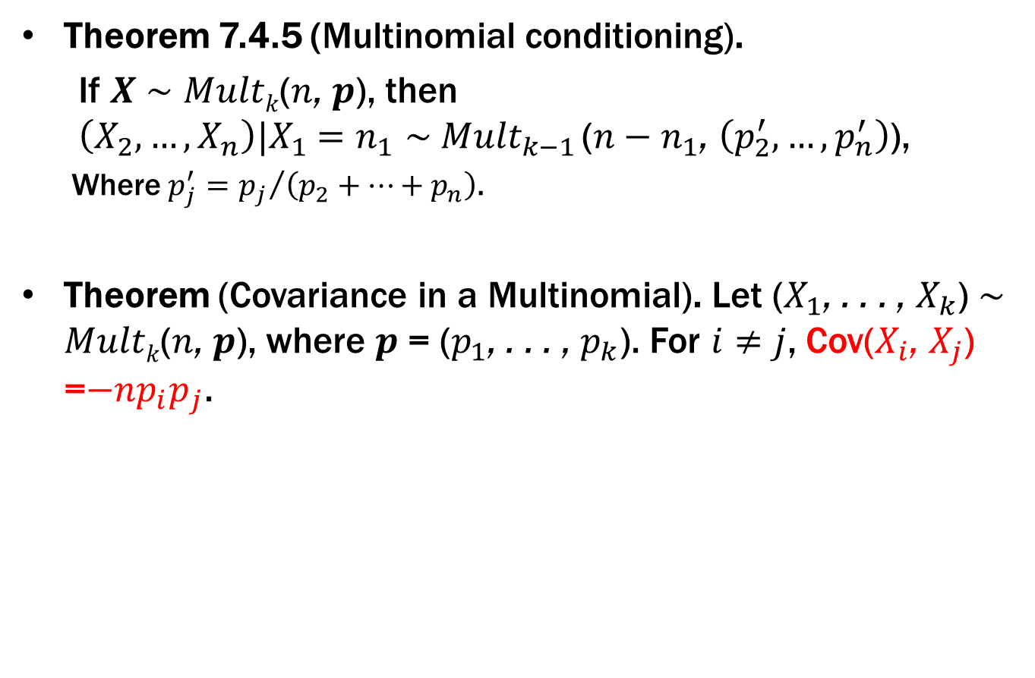
7.2 Common Multivariate distributions
Theorem 7.4.5 (Multinomial conditioning).
If $X$ $\sim$ $Multk$($n$, $p$), then
$\left(X_{2}, …,X_{n}\right)|X_{1}$ $=n_{1}$ $\sim$ ${Mult}_{k−1}$($n−n_{1}$, $\left(p_{2}^{′}, …,p_{n}^{′}\right)$),
  Where $p_{j}^{′}={p_{j}}/{\left(p_{2}+…+p_{n}\right)}$.
Theorem (Covariance in a Multinomial). Let ($X_{1}$, . . . , $X_{k}$) $\sim$ $Multk$($n$, $p$), where $p$ = ($p_{1}$, . . . , $p_{k}$). For $i≠j$, Cov($X_{i}$, $X_{j}$) =$−np_{i}p_{j}$.

Slide 12
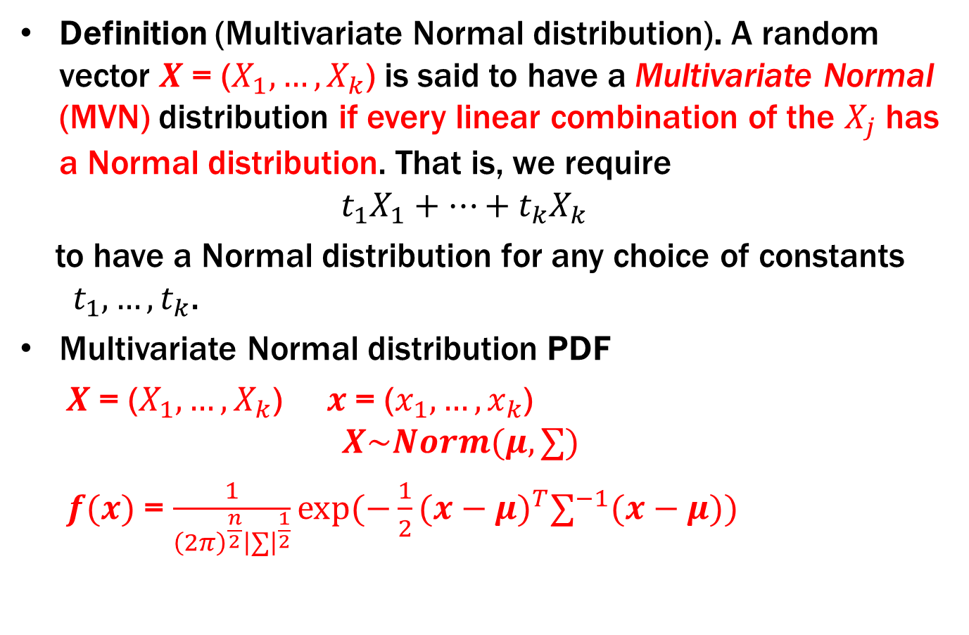
7.2 Common Multivariate distributions
Definition (Multivariate Normal distribution). A random vector $X$= ($X_{1}, …,X_{k}$) is said to have a Multivariate Normal (MVN) distribution if every linear combination of the $X_{j}$ has a Normal distribution. That is, we require
${t_{1}X}_{1}+…+{t_{k}X}_{k}$
to have a Normal distribution for any choice of constants $t_{1}, …,t_{k}$.
Multivariate Normal distribution PDF
  $X$= ($X_{1}, …,X_{k}$) $x$= ($x_{1}, …,x_{k}$)
  $$X\sim Norm(μ,∑)$$
  $f(x)$= $\frac{1}{{\left(2π\right)}^{\frac{n}{2}}{\left|∑\right|}^{\frac{1}{2}}}exp(−\frac{1}{2}{(x−μ)}^{T}∑^{−1}(x−μ))$

Slide 13

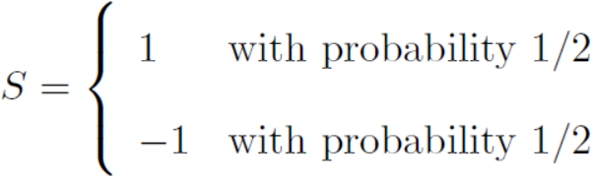


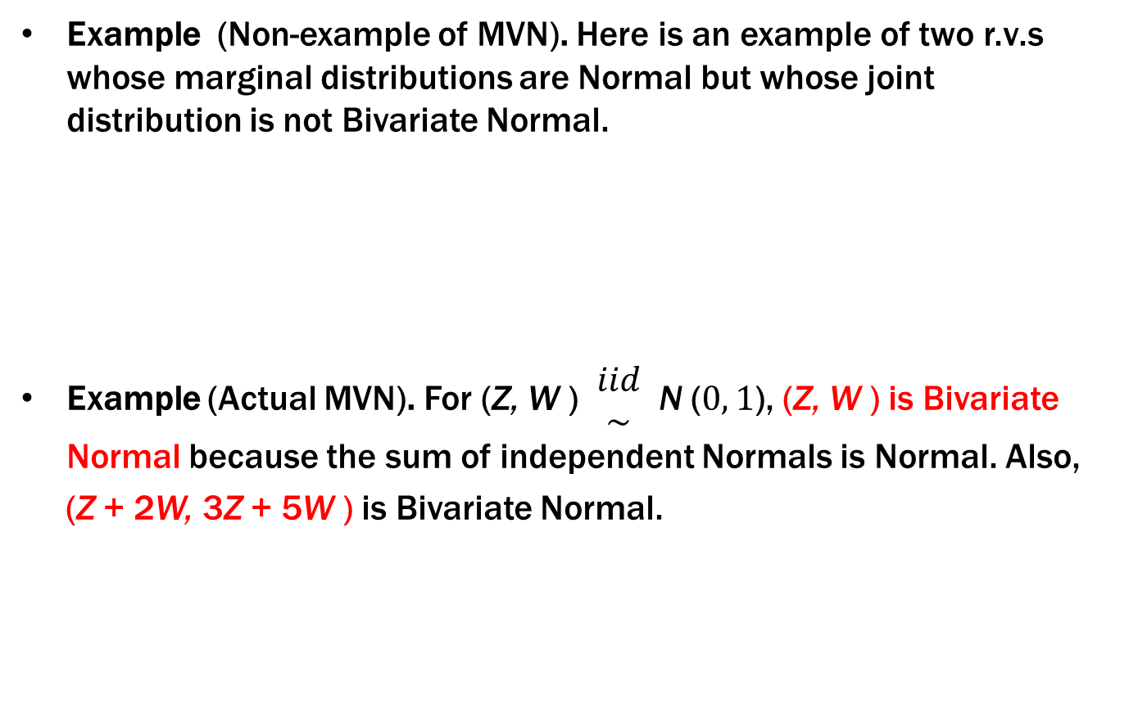
7.2 Common Multivariate distributions
Example (Non-example of MVN). Here is an example of two r.v.s whose marginal distributions are Normal but whose joint distribution is not Bivariate Normal.
Example (Actual MVN). For (Z, W ) $\begin{matrix}iid \\ \sim \end{matrix}$ N ($0, 1$), (Z, W ) is Bivariate Normal because the sum of independent Normals is Normal. Also,
(Z + 2W, 3Z + 5W ) is Bivariate Normal.

Slide 14
7.2 Common Multivariate distributions
Theorem 7.5.4. If (X₁, X₂, X₃) is Multivariate Normal, then so is the subvector (X₁, X₂).
Theorem 7.5.5. If X = (X₁, . . . , X_{n}) and Y = (Y₁, . . . , Y_{m}) are MVN vectors with X independent of Y, then the concatenated random vector W = (X₁, . . . , X_{n}, Y₁, . . . , Y_{m}) is Multivariate Normal.

Slide 15
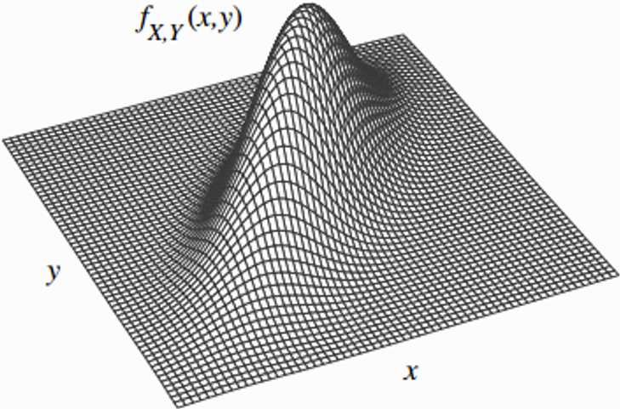
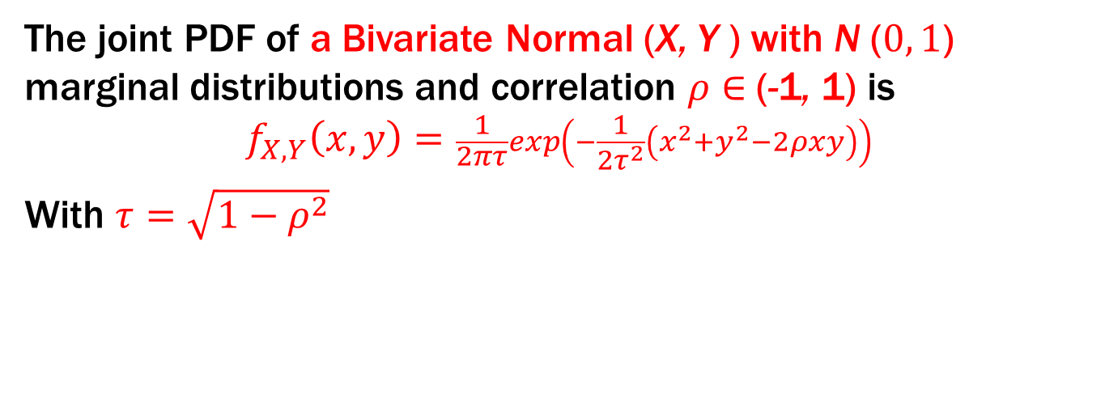
7.2 Common Multivariate distributions
The joint PDF of a Bivariate Normal (X, Y ) with N ($0, 1$) marginal distributions and correlation $ρ∈$(-1, 1) is
$$f_{X,Y}\left(x,y\right)=\frac{1}{2πτ}exp\left(−\frac{1}{2τ^{2}}\left(x^{2}+y^{2}−2ρxy\right)\right)$$
With $τ=\sqrt{1−ρ^{2}}$

Slide 16
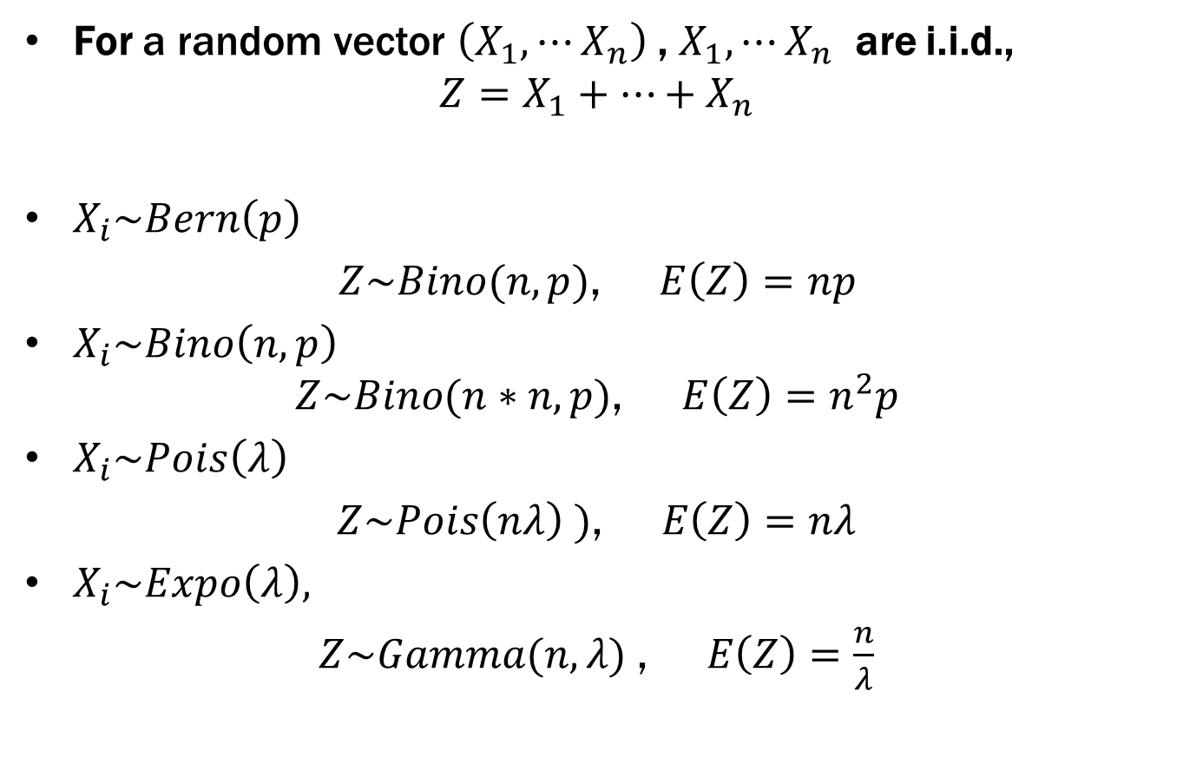
7.3 Function of Multivariate Random variable
For a random vector $\left(X_{1},⋯X_{n}\right)$, $X_{1},⋯X_{n}$ are i.i.d.,
$${Z=X}_{1}+⋯+X_{n}$$
$X_{i}\sim Bern\left(p\right)$
$Z\sim Bino(n,p)$, $E\left(Z\right)=np$
$X_{i}\sim Bino\left(n,p\right)$
$$Z\sim Bino(n∗n,p)\text{, } E\left(Z\right)=n^{2}p$$
$X_{i}\sim Pois\left(λ\right)$
$Z\sim Pois\left(nλ\right)$ $)\text{, } E\left(Z\right)=nλ$
$X_{i}\sim Expo\left(λ\right),$
$Z\sim Gamma(n,λ)$ $\text{, } E\left(Z\right)=\frac{n}{λ}$

Slide 17
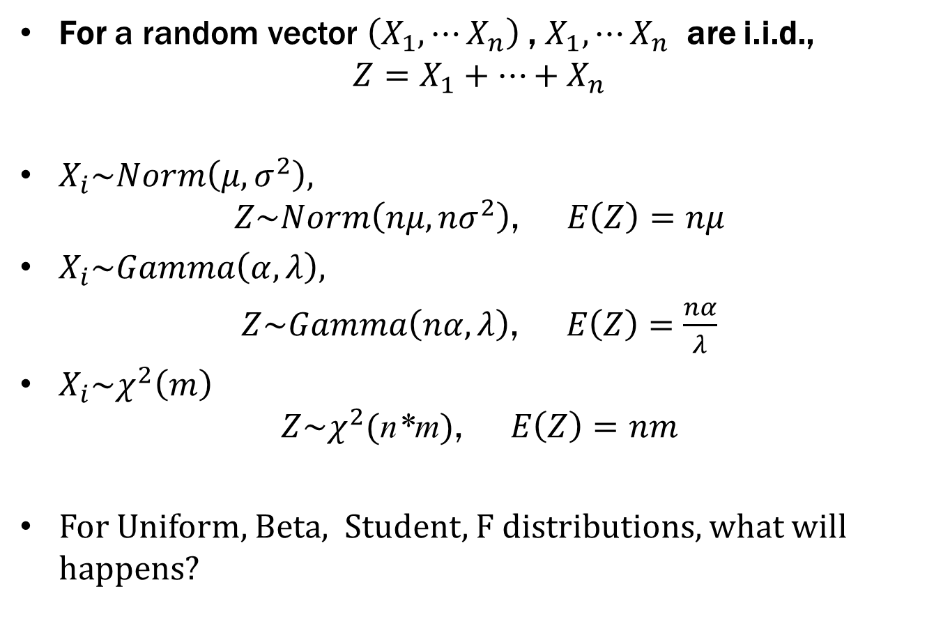
7.3 Function of Multivariate Random variable
For a random vector $\left(X_{1},⋯X_{n}\right)$, $X_{1},⋯X_{n}$ are i.i.d.,
$${Z=X}_{1}+⋯+X_{n}$$
$X_{i}\sim Norm\left(μ,σ^{2}\right),$
$$Z\sim Norm\left(nμ,{nσ}^{2}\right)\text{, } E\left(Z\right)=nμ$$
$X_{i}\sim Gamma\left(α,λ\right),$
$Z\sim Gamma\left(nα,λ\right)\text{, } E\left(Z\right)=$ $\frac{nα}{λ}$
$X_{i}\sim χ^{2}\left(m\right)$
$$Z\sim χ^{2}\text{(}\text{n}\text{∗}\text{m}\text{)}\text{, } E\left(Z\right)=nm$$
For Uniform, Beta, Student, F distributions, what will happens?

Slide 18

7.3 Function of Multivariate Random variable
For a random vector $\left(X_{1},⋯X_{n}\right)$, $X_{1},⋯X_{n}$ are i.i.d.,
$${Z=Max(X}_{1},⋯,X_{n})$$
Known : $F(x)$, $f(x)$ for X
$CDF$
$$F_{Z}(z)=[F(z)]^{n},\begin{matrix} & −∞<z<+∞\end{matrix}$$
$PDF$
$$f_{Z}(z)=n[F(z)]^{n−1}f(z)\begin{matrix} & −∞<z<+∞\end{matrix}$$

Slide 19

7.3 Function of Multivariate Random variable
For a random vector $\left(X_{1},⋯X_{n}\right)$, $X_{1},⋯X_{n}$ are i.i.d.,
$${Z=Min(X}_{1},⋯,X_{n})$$
Known : $F(x)$, $f(x)$ for X
$CDF$
$$F_{Y}(y)=1−[1−F(y)]^{n},\begin{matrix} & −∞<y<+∞\end{matrix}$$
$PDF$
$$f_{Y}(y)=n[1−F(y)]^{n−1}f(y)\begin{matrix} & −∞<y<+∞\end{matrix}$$

Slide 20
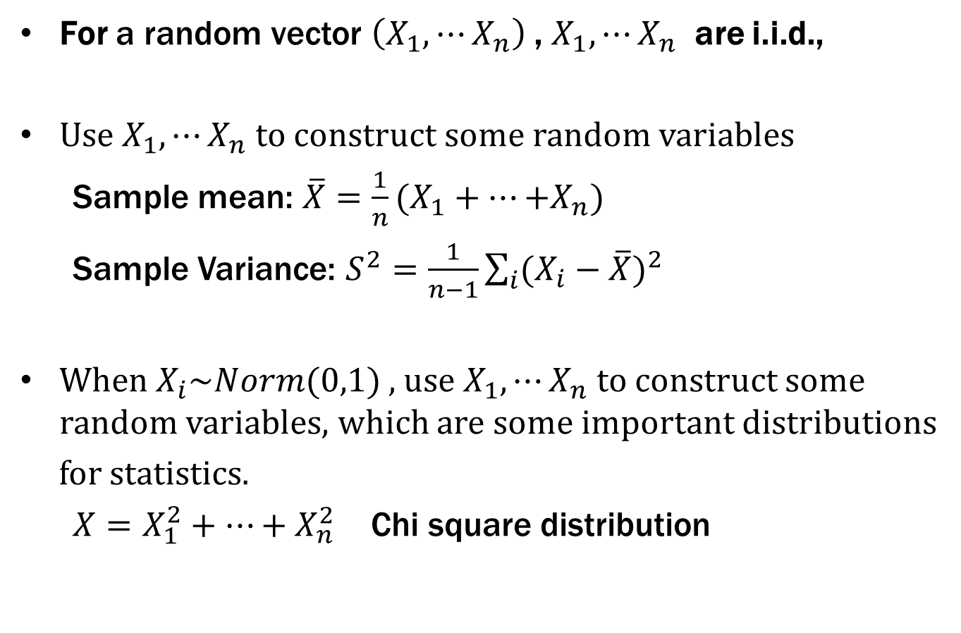
7.3 Function of Multivariate Random variable
For a random vector $\left(X_{1},⋯X_{n}\right)$, $X_{1},⋯X_{n}$ are i.i.d.,
Use $X_{1},⋯X_{n}$ to construct some random variables
Sample mean: ${\overline{X}=\frac{1}{n}(X}_{1}+⋯{+X}_{n})$
Sample Variance: $S^{2}=\frac{1}{n−1}\sum_{i}{{(X_{i}−\overline{X})}^{2}}$
When $X_{i}\sim Norm(0,1)$, use $X_{1},⋯X_{n}$ to construct some random variables, which are some important distributions
for statistics.
${X=X}_{1}^{2}+⋯+X_{n}^{2}$ Chi square distribution

Slide 21
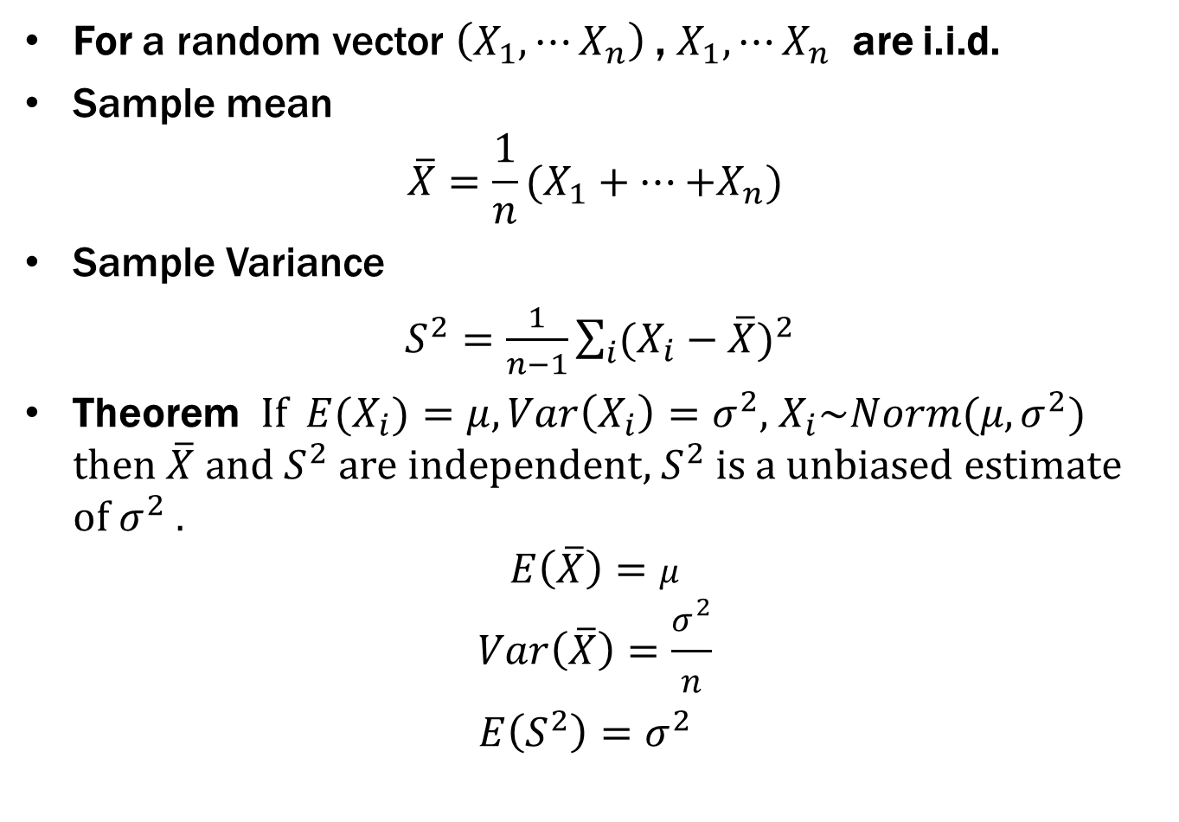
7.4 Sample mean and sample variance
For a random vector $\left(X_{1},⋯X_{n}\right)$, $X_{1},⋯X_{n}$ are i.i.d.
Sample mean
$${\overline{X}=\frac{1}{n}(X}_{1}+⋯{+X}_{n})$$
Sample Variance
$S^{2}=\frac{1}{n−1}\sum_{i}{{(X_{i}−\overline{X})}^{2}}$
Theorem If ${E(X}_{i})=μ,Var\left(X_{i}\right)=σ^{2}$, $X_{i}\sim Norm(μ,σ^{2})$ then $\overline{X}$ and $S^{2}$ are independent, $S^{2}$ is a unbiased estimate of $σ^{2}$ .
$$E\left(\overline{X}\right)=μ$$
$$Var\left(\overline{X}\right)=\frac{σ^{2}}{n}$$
$E\left(S^{2}\right)=σ^{2}$

Slide 22
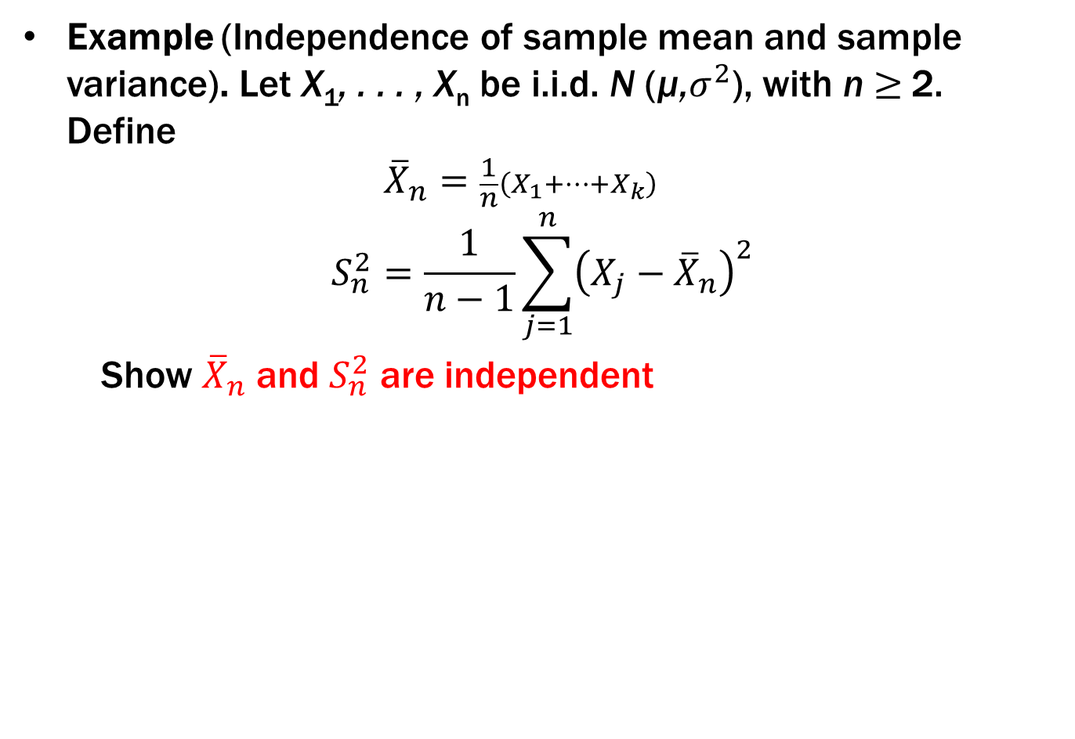
7.4 Sample mean and sample variance
Example (Independence of sample mean and sample variance). Let X₁, . . . , X_{n} be i.i.d. N (µ,$σ^{2}$), with n $≥$2. Define
${\overline{X}}_{n}=\frac{1}{n}\left(X_{1}+…+X_{k}\right)$
$$S_{n}^{2}=\frac{1}{n−1}\sum_{j=1}^{n}{{\left(X_{j}−{\overline{X}}_{n}\right)}^{2}}$$
Show ${\overline{X}}_{n}$ and $S_{n}^{2}$ are independent

Slide 23
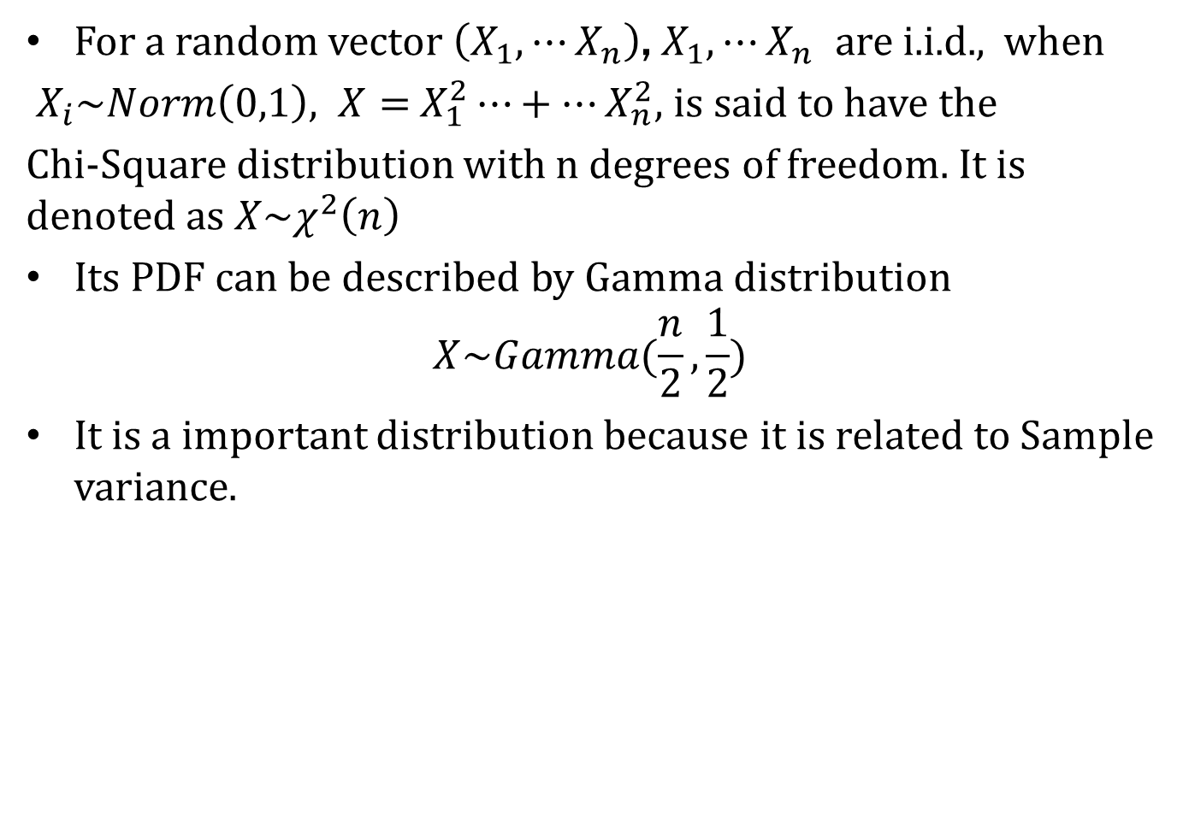
7.5 Some distributions for statistics
For a random vector $\left(X_{1},⋯X_{n}\right)$, $X_{1},⋯X_{n}$ are i.i.d., when
$X_{i}\sim Norm\left(0,1\right), X=$ $X_{1}^{2}⋯+⋯X_{n}^{2},$is said to have the
Chi-Square distribution with n degrees of freedom. It is denoted as $X\sim χ^{2}\left(n\right)$
Its PDF can be described by Gamma distribution
$$X\sim Gamma(\frac{n}{2},\frac{1}{2})$$
It is a important distribution because it is related to Sample variance.

Slide 24
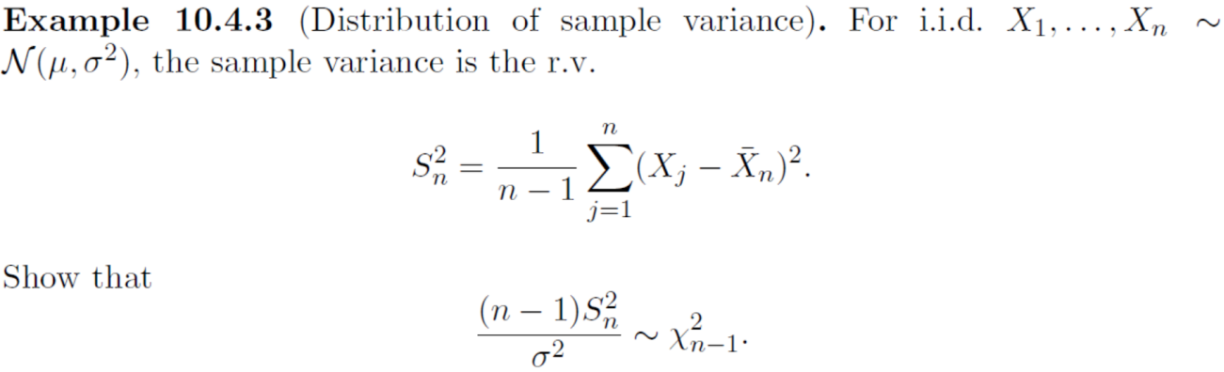

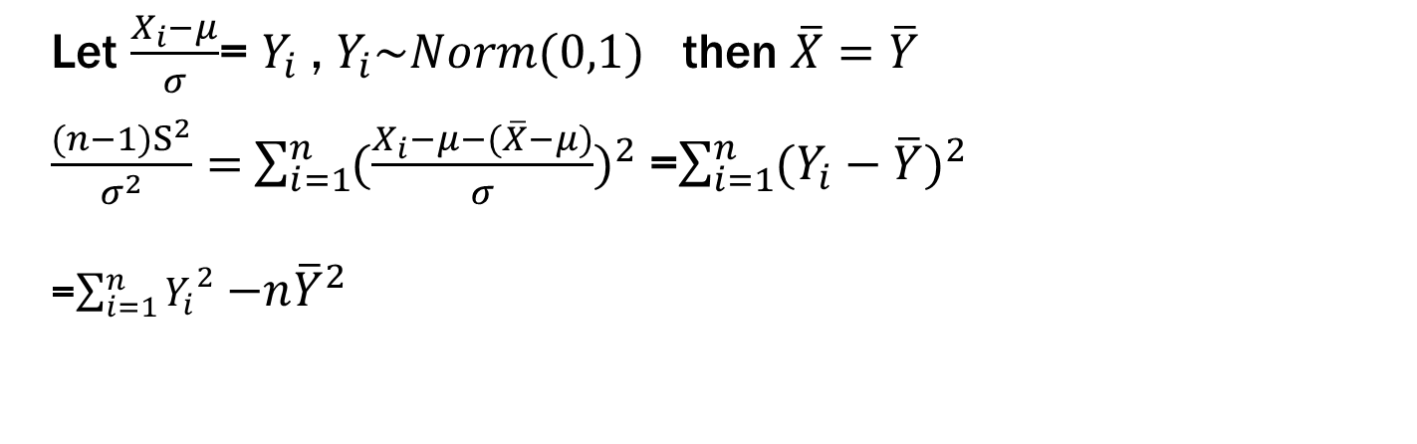
7.5 Some distributions for statistics
Let $\frac{X_{i}−μ}{σ}$= $Y_{i}$ , $Y_{i}\sim Norm(0,1)$ then $\overline{X}=\overline{Y}$
$\frac{(n−1)S^{2}}{σ^{2}}=$ $\sum_{i=1}^{n}{{(\frac{X_{i}−μ−(\overline{X}−μ)}{σ})}^{2}}$ =$\sum_{i=1}^{n}{{(Y_{i}−\overline{Y})}^{2}}$
=$\sum_{i=1}^{n}{{Y_{i}}^{2}}$ ${−n\overline{Y}}^{2}$

Slide 25

7.5 Some distributions for statistics
For a random vector $\left(X_{1},⋯X_{n}\right)$, $X_{1},⋯X_{n}$ are i.i.d., when
$X_{i}\sim Norm\left(μ,σ^{2}\right), X=$ $\sum_{i=1}^{n}{{(\frac{X_{i}−μ}{σ})}^{2}} , then X\sim χ^{2}\left(n\right)$

Slide 26
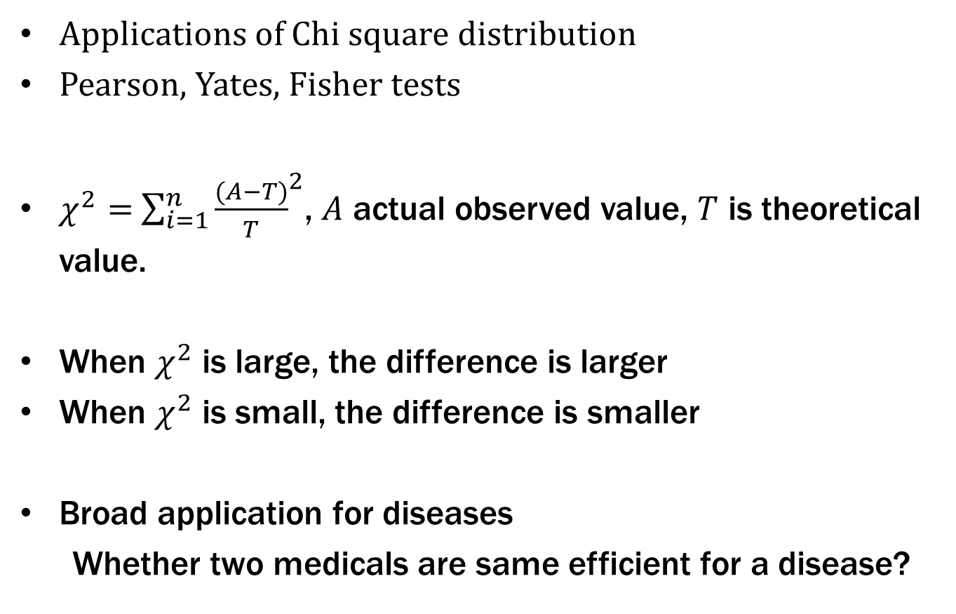
7.5 Some distributions for statistics
Applications of Chi square distribution
Pearson, Yates, Fisher tests
$χ^{2}=$ $\sum_{i=1}^{n}{{\frac{(A−T)}{T}}^{2}}$, $A$ actual observed value, $T$ is theoretical value.
When $χ^{2}$ is large, the difference is larger
When $χ^{2}$ is small, the difference is smaller
Broad application for diseases
Whether two medicals are same efficient for a disease?

Slide 27
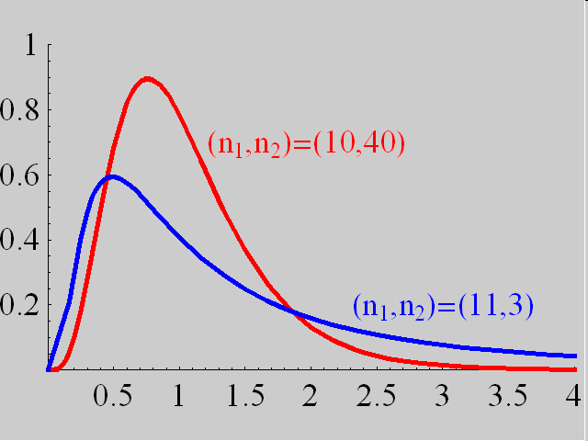
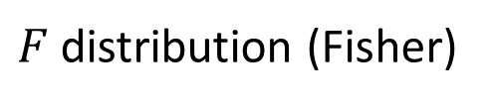



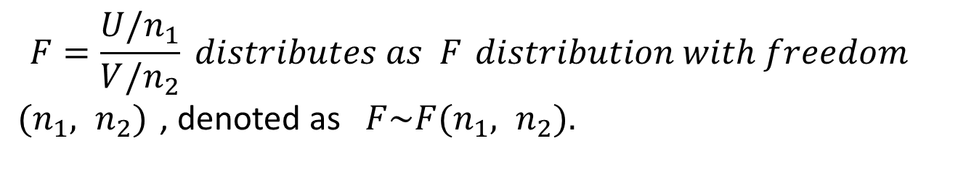
7.5 Some distributions for statistics
$F$distribution (Fisher)
$$Let U\sim χ^{2}(n_{1}),$$
$$V\sim χ^{2}(n_{2}),$$
$$and U, V are independent,$$
$$F=\frac{U/n_{1}}{V/n_{2}} distributes as F distribution with freedom$$
$(n_{1}, n_{2})$, denoted as$F\sim F(n_{1}, n_{2}).$

Slide 28
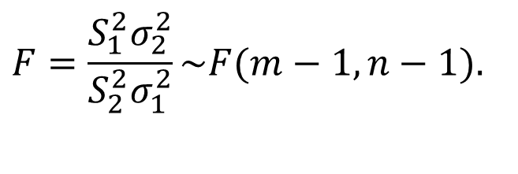
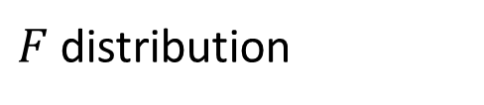
7.5 Some distributions for statistics
$F$distribution
$F$distribution is a important distribution for variance analysis
$$X_{1},⋯,X_{m}, X_{i}\sim N(μ_{1},σ_{1}^{2}),$$
$$X_{1},⋯,X_{n}, X_{j}\sim N(μ_{2},σ_{2}^{2}),$$
$$F=\frac{S_{1}^{2}σ_{2}^{2}}{S_{2}^{2}σ_{1}^{2}}\sim F(m−1,n−1).$$

Slide 29
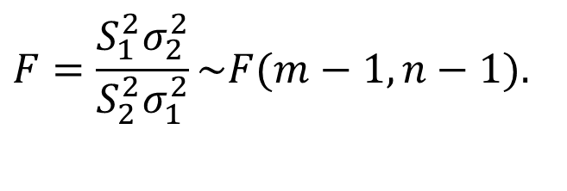
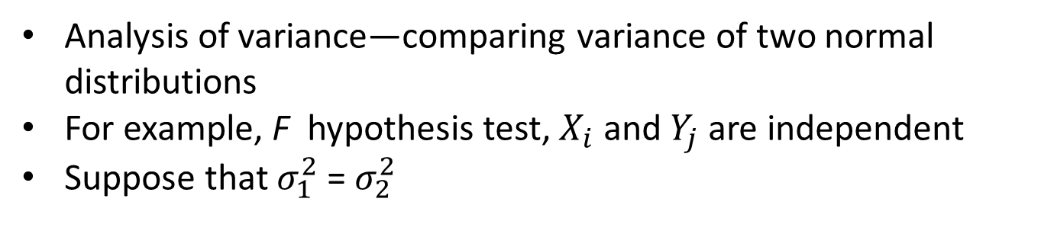
7.5 Some distributions for statistics
Applications of $F$distribution( homogeneity test of variance )
Analysis of variance—comparing variance of two normal distributions
For example, F hypothesis test, $X_{i}$ and $Y_{j}$ are independent
Suppose that $σ_{1}^{2}$=${ σ}_{2}^{2}$
$$X_{1},⋯,X_{m}, X_{i}\sim N(μ_{1},σ_{1}^{2}),$$
$$Y_{1},⋯,Y_{n}, Y_{j}\sim N(μ_{2},σ_{2}^{2}),$$
$$F=\frac{S_{1}^{2}σ_{2}^{2}}{S_{2}^{2}σ_{1}^{2}}\sim F(m−1,n−1).$$

Slide 30
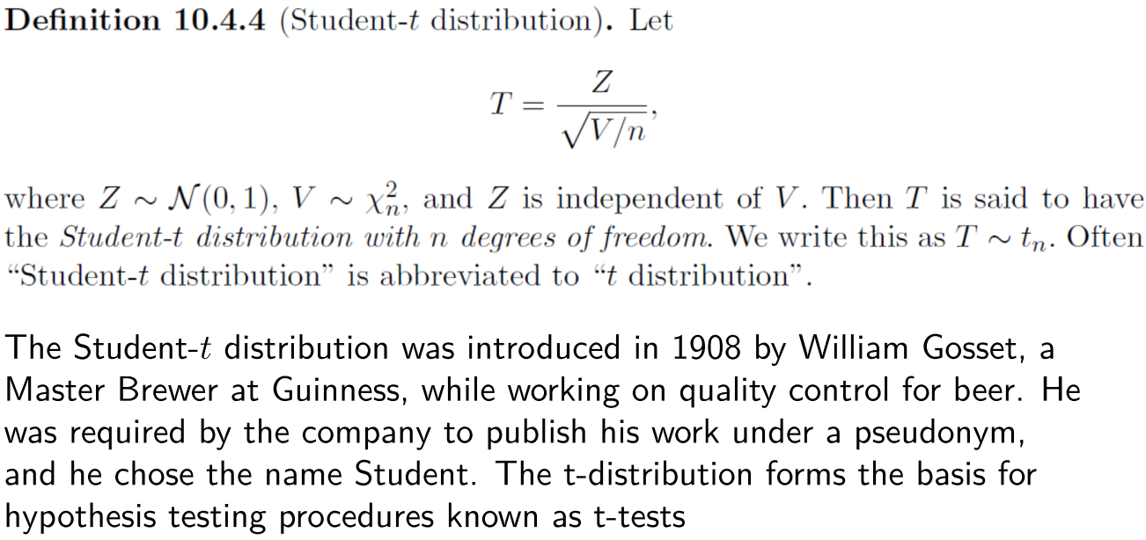
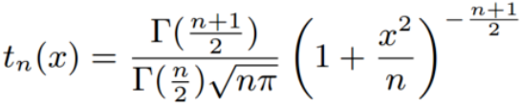

7.5 Some distributions for statistics
PDF of T

Slide 31
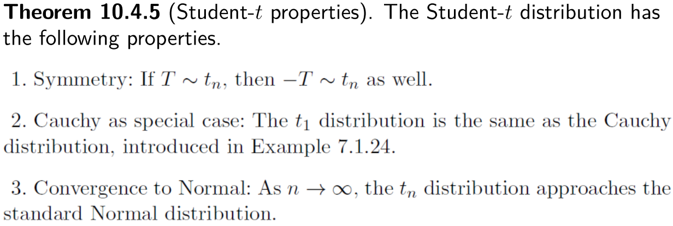
7.5 Some distributions for statistics

Slide 32
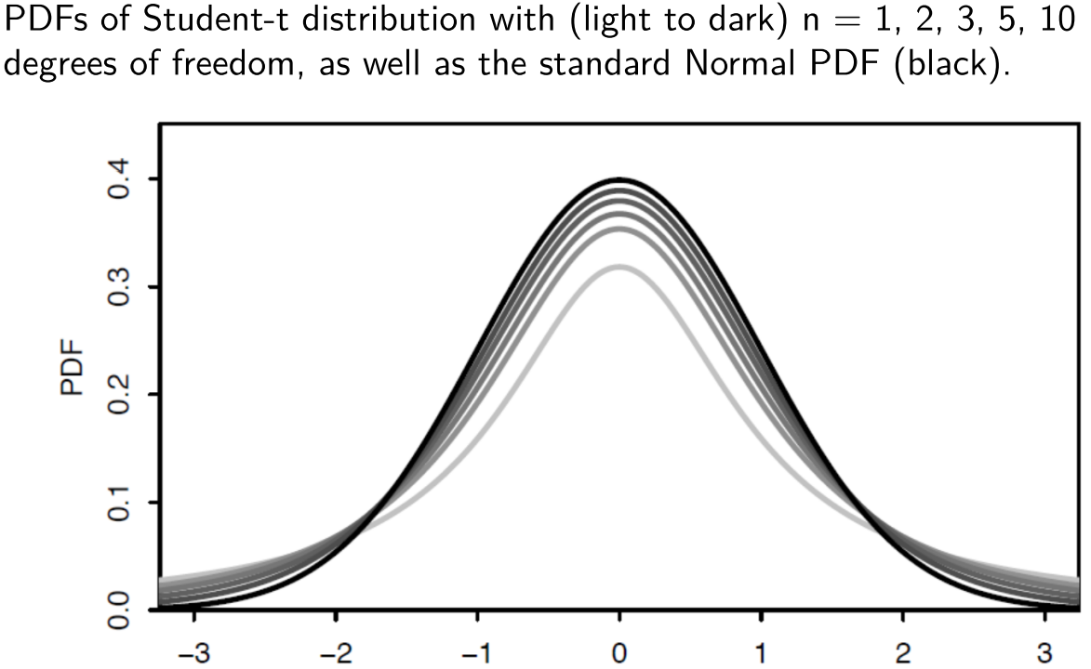
7.5 Some distributions for statistics

Slide 33
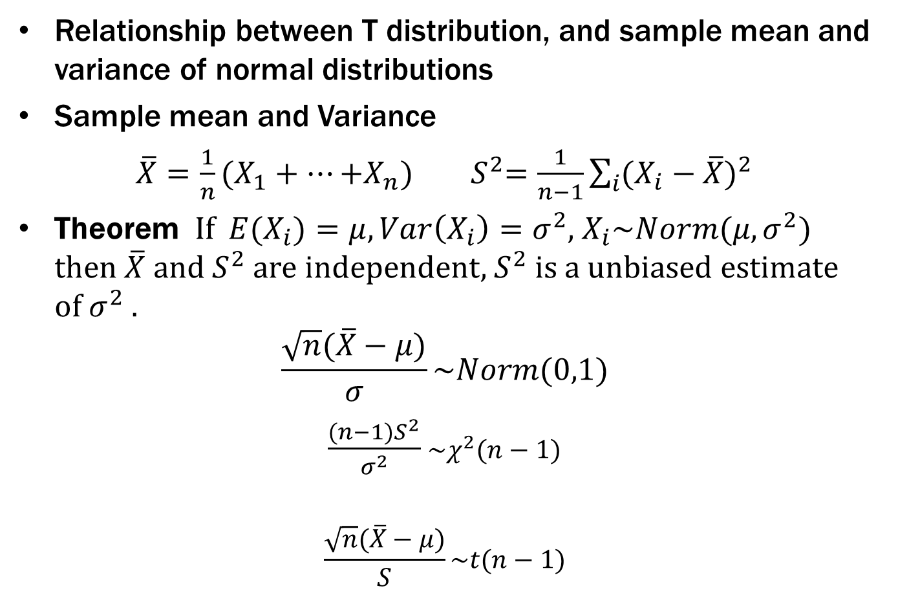
7.5 Some distributions for statistics
Relationship between T distribution, and sample mean and variance of normal distributions
Sample mean and Variance
${\overline{X}=\frac{1}{n}(X}_{1}+⋯{+X}_{n})$ ${ S}^{2}=\frac{1}{n−1}\sum_{i}{{(X_{i}−\overline{X})}^{2}}$
Theorem If ${E(X}_{i})=μ,Var\left(X_{i}\right)=σ^{2}$, $X_{i}\sim Norm(μ,σ^{2})$ then $\overline{X}$ and $S^{2}$ are independent, $S^{2}$ is a unbiased estimate of $σ^{2}$ .
$$\frac{\sqrt{n}(\overline{X}−μ)}{σ}\sim Norm(0,1)$$
$\frac{(n−1)S^{2}}{σ^{2}}$ $\sim χ^{2}(n−1)$
$$\frac{\sqrt{n}(\overline{X}−μ)}{S}\sim t(n−1)$$

Slide 34
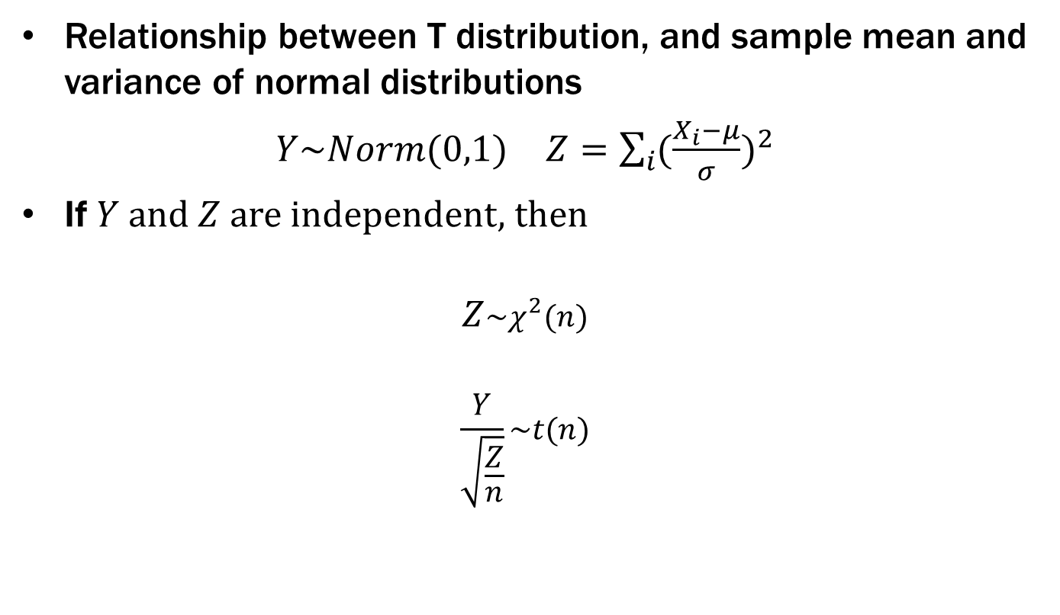
7.5 Some distributions for statistics
Relationship between T distribution, and sample mean and variance of normal distributions
$Y\sim Norm(0,1)$ $Z=\sum_{i}{{(\frac{X_{i}−μ}{σ})}^{2}}$
If $Y$and $Z$ are independent, then
$$Z\sim χ^{2}(n)$$
$$\frac{Y}{\sqrt{\frac{Z}{n}}}\sim t(n)$$

